Slide 1
Security in Computing, Fifth Edition
Chapter 1: Introduction

Slide 2
About me
赖祥伟
Tel:13983258288
QQ:1110128
Mail: lxw@swu.edu.cn

Slide 3
Objectives for Chapter 1
Define computer security as well as basic computer security terms
Introduce the C-I-A Triad
Introduce basic access control terminology
Explain basic threats, vulnerabilities, and attacks
Show how controls map to threats

Slide 4
What Is Computer Security?
The protection of the assets of a computer system
Hardware
Software
Data

Slide 5
Assets

Slide 6
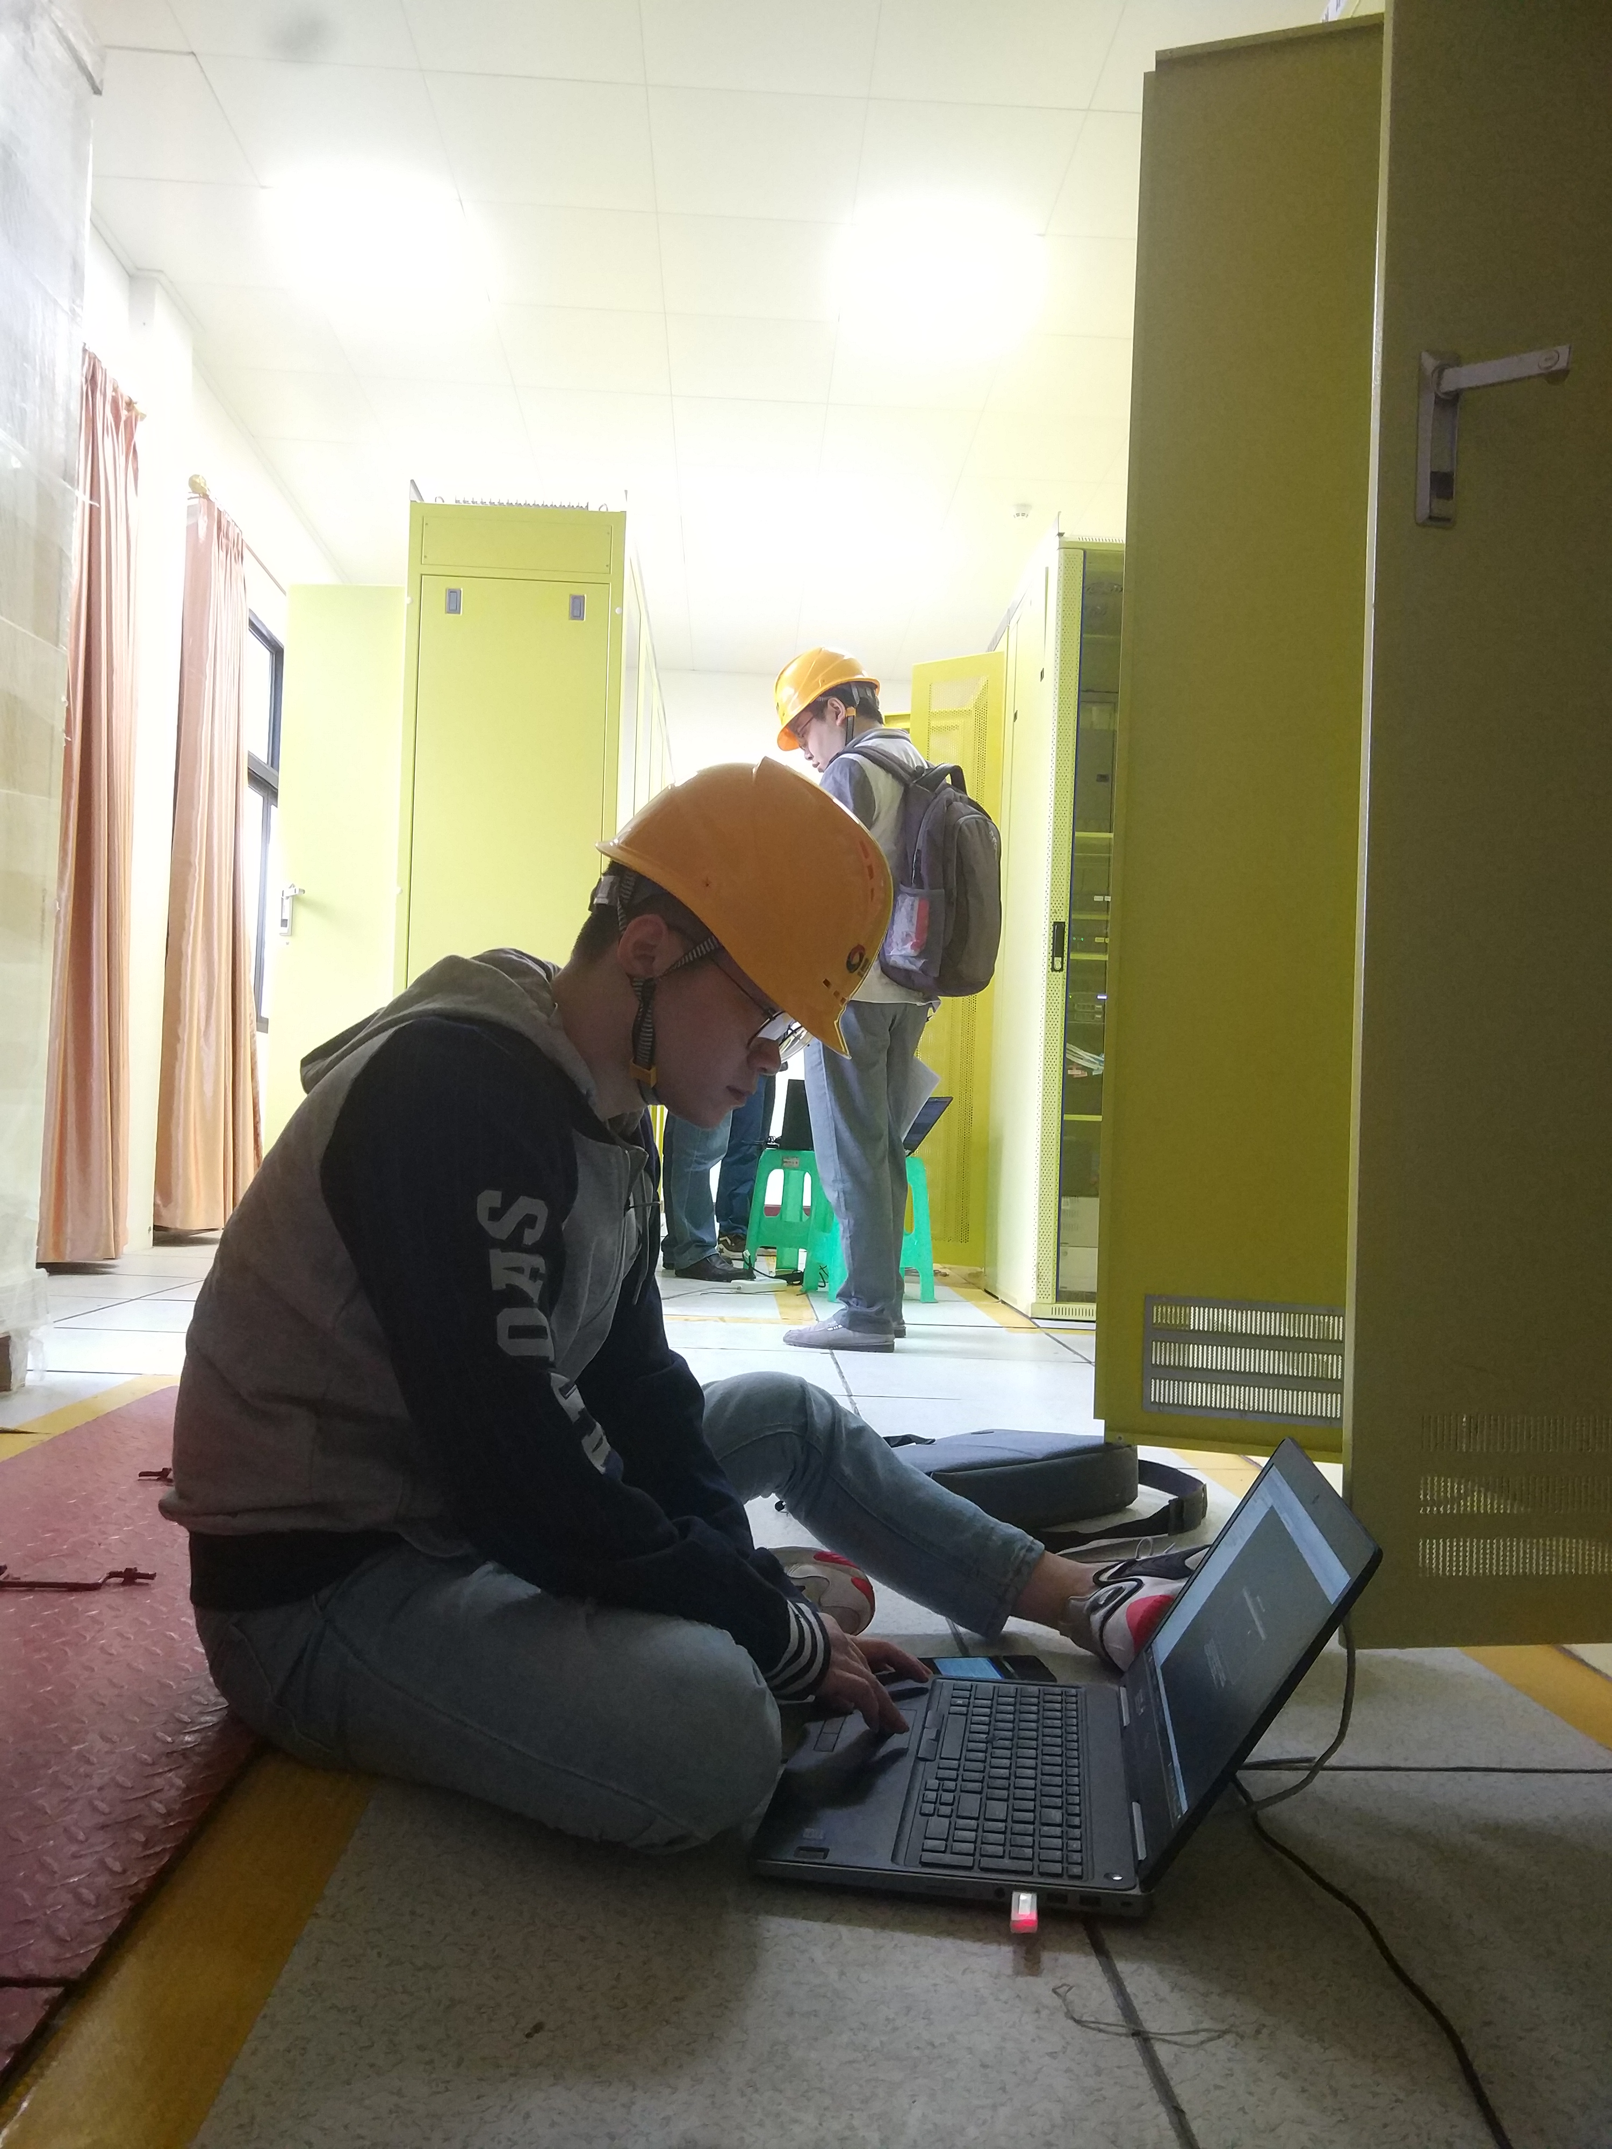
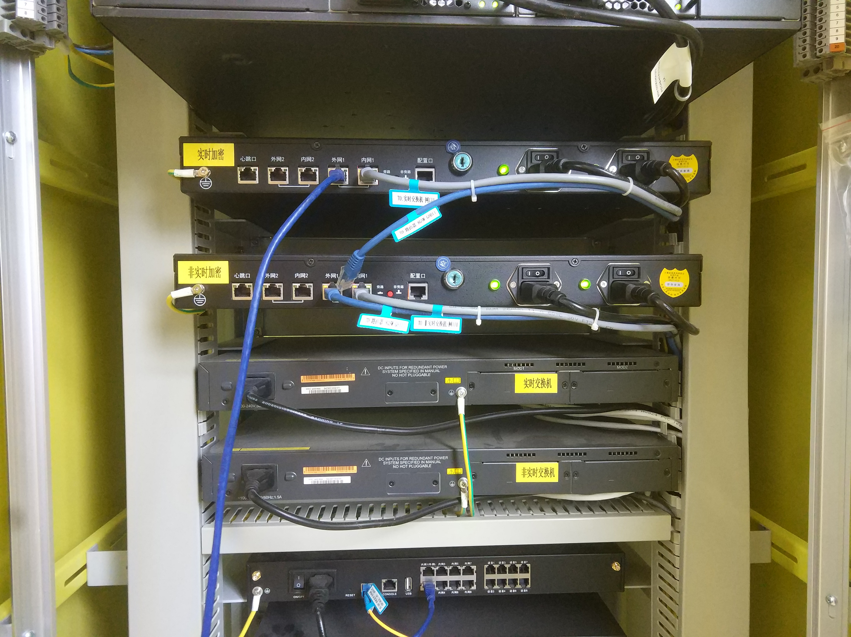

Slide 7
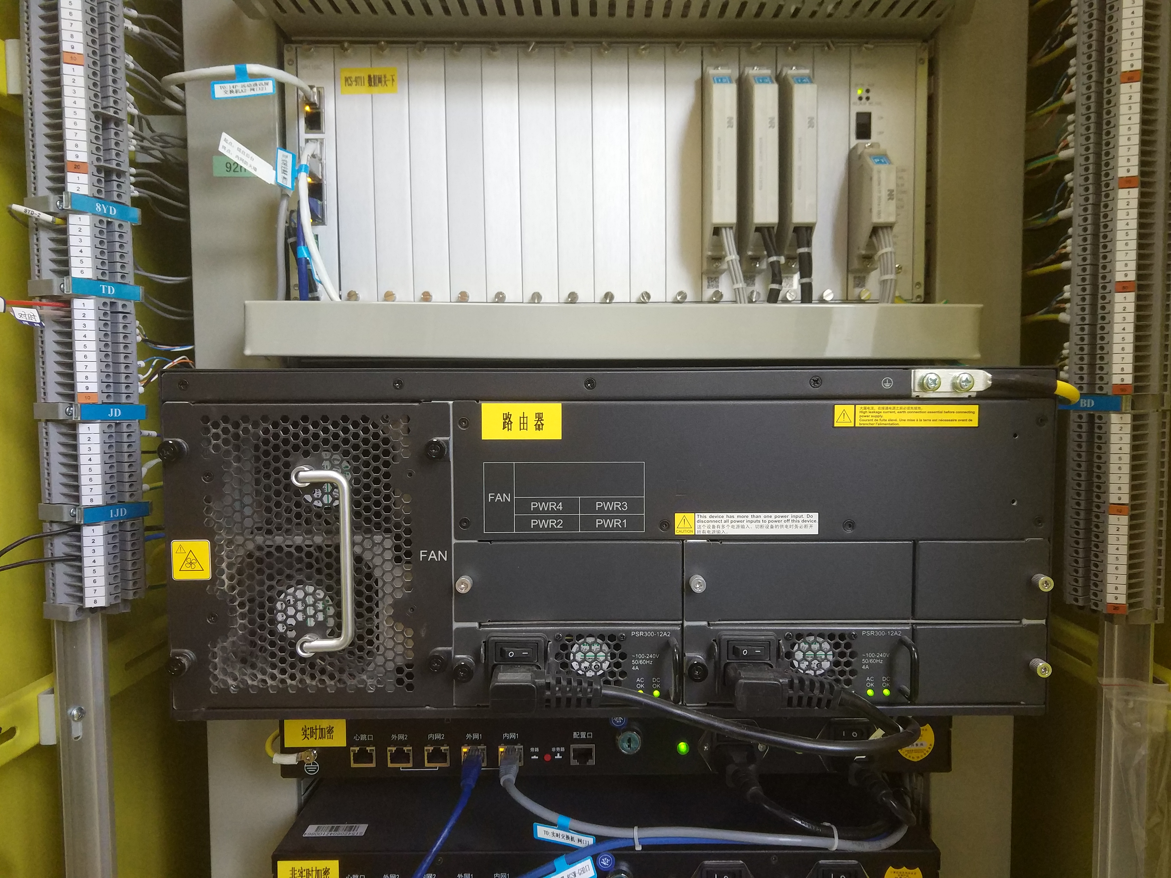

Slide 8
Values of Assets
Notes:
While hardware and software may be expensive, unique data cannot be replaced if it is lost.

Slide 9
Basic Terms
Vulnerability
Threat
Attack
Countermeasure or control
Notes:
There will be further discussion of each later in the chapter.

Slide 10
Threat and Vulnerability
Notes:
The water is the threat, the crack the vulnerability, and the finger the control (for now).

Slide 11
C-I-A Triad
Confidentiality
Integrity
Availability
Sometimes two other desirable characteristics:
Authentication
Nonrepudiation
资产
Confidentiality
Availability
Integrity

Slide 12
Access Control
Notes:
Visual explanation of basic access control terms

Slide 13
Types of Threats
Notes:
This diagram shows threats categorized according to whether they are human-caused, malicious, or directed. These characteristics will affect security planning in important ways later.

Slide 14
Advanced Persistent Threat (APT)
Organized
Directed
Well financed
Patient
Silent
Notes:
APT is a special type of threat that has only been taken seriously by the broad security community over the past decade. In general, security experts believe that no one who becomes a high-priority target can truly be safe from APT.

Slide 15
Types of Attackers
Notes:
Each of these attacker types is associated with a different set of resources, capabilities, and motivations. Understanding the different types will help later in considering threats.

Slide 16
Types of Harm
Notes:
These are the primary types of harm against system data and functions. Understanding these possibilities is important to considering threat and risk.

Slide 17
Method—Opportunity--Motive
Notes:
Understanding method, motive, and opportunity can be a good way to think about potential threats. Reducing any of those dimensions can lower the risk to the system.

Slide 18
Controls/Countermeasures
Notes:
This representation shows the three dimensions by which a control can be categorized. Thinking about controls in this way enables you to easily map the controls against the threats they help address.

Slide 19
Different Types of Controls
Notes:
In this simple representation of a networked system, it is easy to see all the touch points where controls can be placed, as well as some different types of controls, including deterrence, deflection, response, prevention, and preemption.

Slide 20
Summary
Vulnerabilities are weaknesses in a system; threats exploit those weaknesses; controls protect those weaknesses from exploitation
Confidentiality, integrity, and availability are the three basic security primitives
Different attackers pose different kinds of threats based on their capabilities and motivations
Different controls address different threats; controls come in many flavors and can exist at various points in the system

